Slide 1
Multi Model Data Fusion Diagnostic Assistant
SlideMake.com

Slide 2

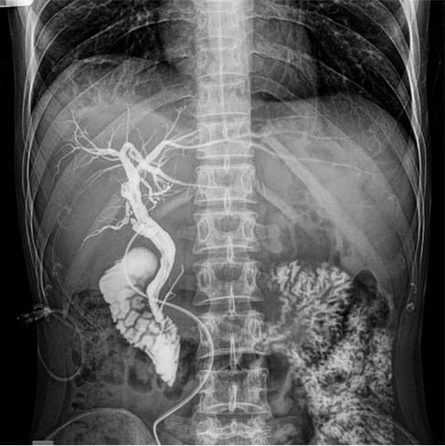
Introduction to Multi-Model Data Fusion Diagnostic Assistant
This presentation introduces the concept of a multi-model data fusion diagnostic assistant.
It explains how combining multiple data sources enhances diagnostic accuracy and decision-making.
The goal is to provide a comprehensive overview of the system's components, benefits, and applications.
Notes:
Image source: https://www.slidemake.com

Slide 3
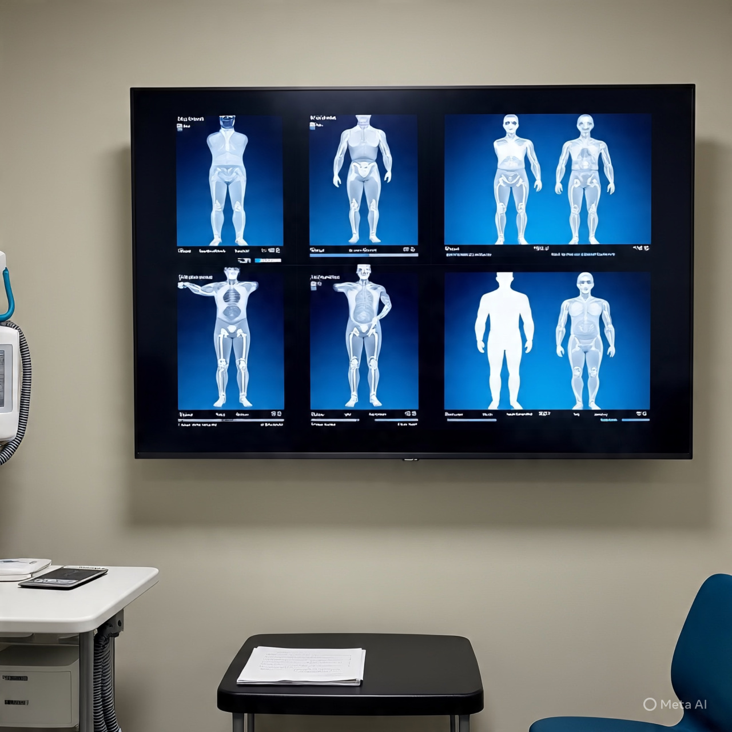
What is Multi-Model Data Fusion?
Multi-model data fusion integrates data from various models or sensors to improve system understanding.
It leverages complementary information to reduce uncertainty and increase robustness.
This approach is widely used in complex diagnostics, such as healthcare, manufacturing, and aerospace.
Notes:
Image source: https://image1.slideserve.com

Slide 4
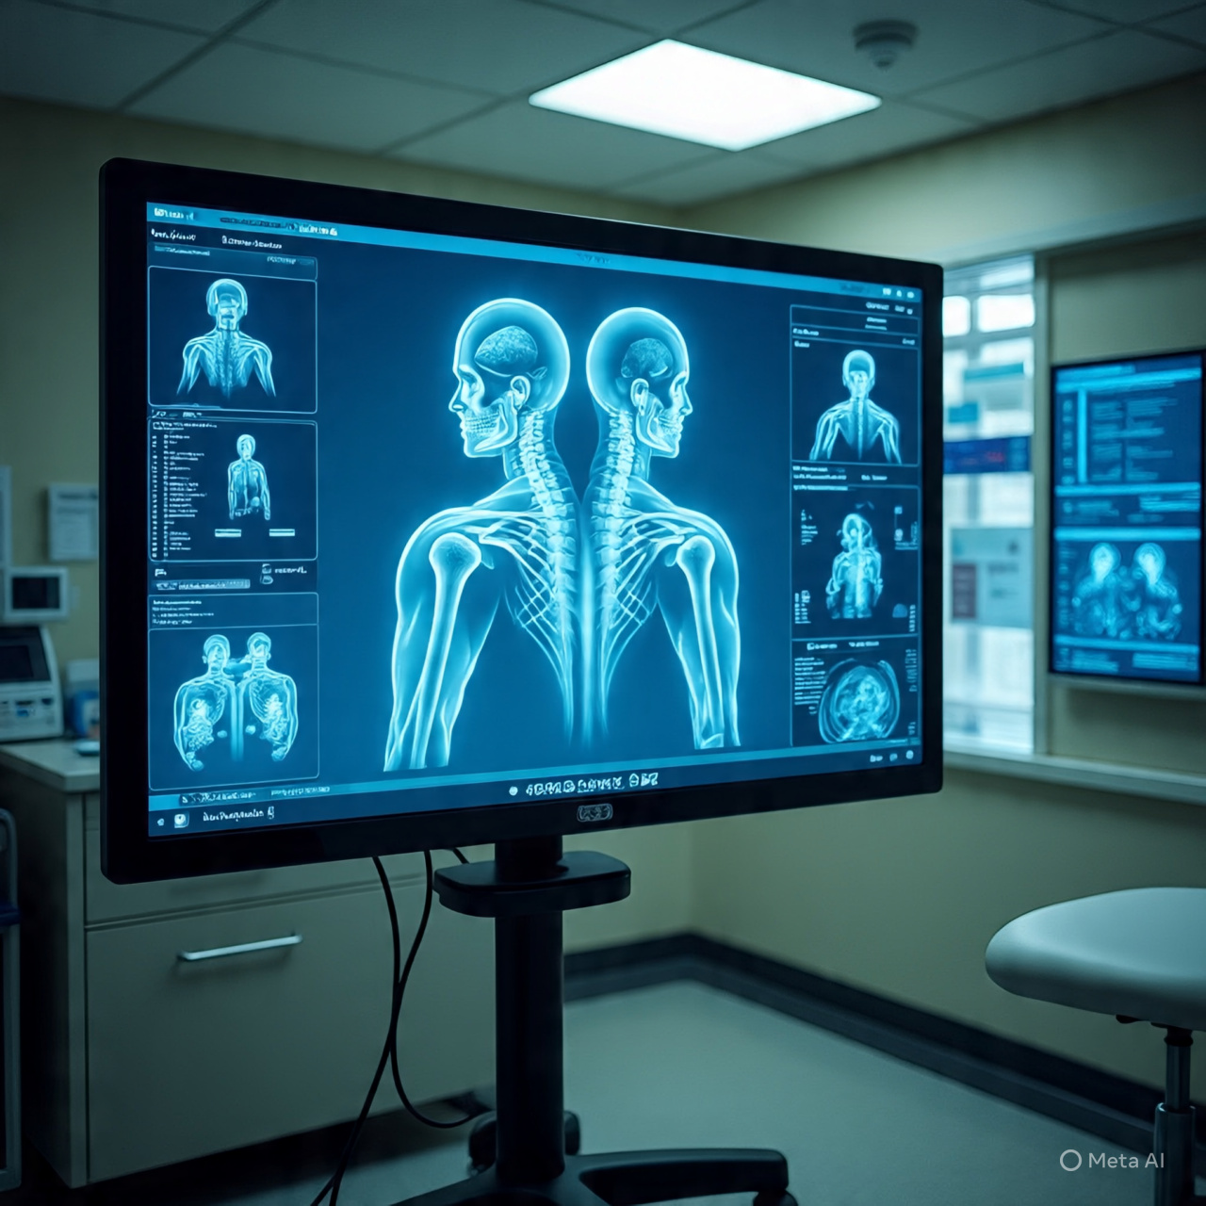
Components of the Diagnostic Assistant
Key components include data acquisition modules, data processing units, and decision support algorithms.
Machine learning models are often employed to interpret fused data effectively.
User interface components enable clinicians or operators to visualize and interact with the diagnostic results.
Notes:
Image source: https://www.slidemake.com

Slide 5
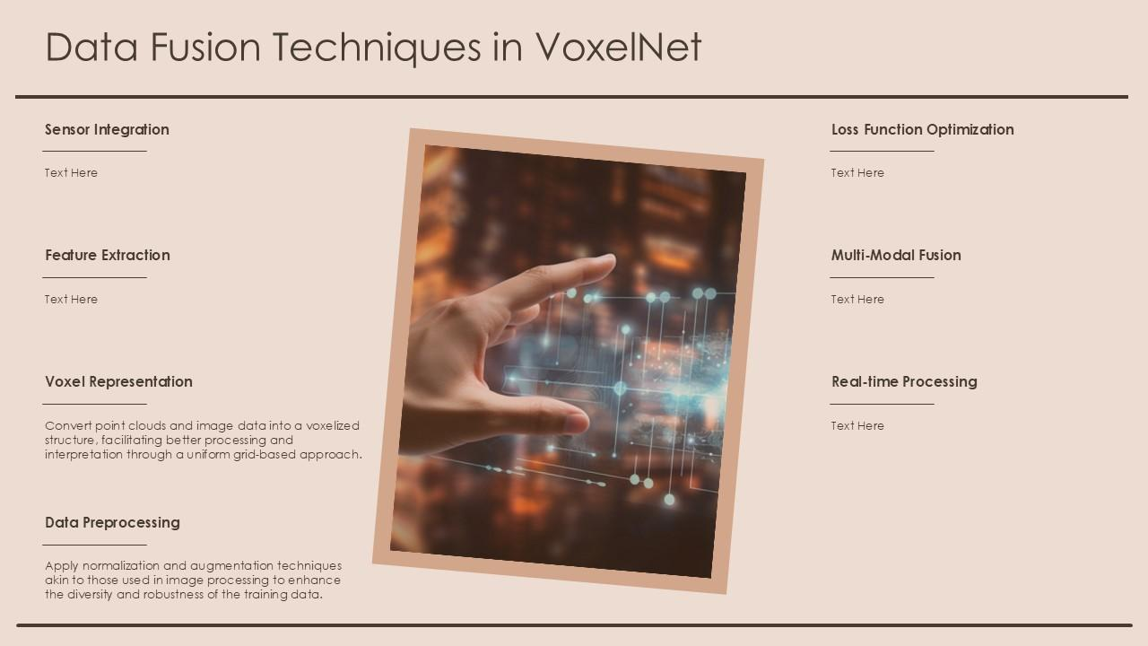
Techniques Used in Data Fusion
Techniques such as Kalman filtering, Bayesian inference, and neural networks are commonly utilized.
These methods help in merging data streams and managing uncertainty within the system.
The choice of technique depends on data type, system complexity, and real-time processing needs.
Notes:
Image source: https://www.slideteam.net

Slide 6
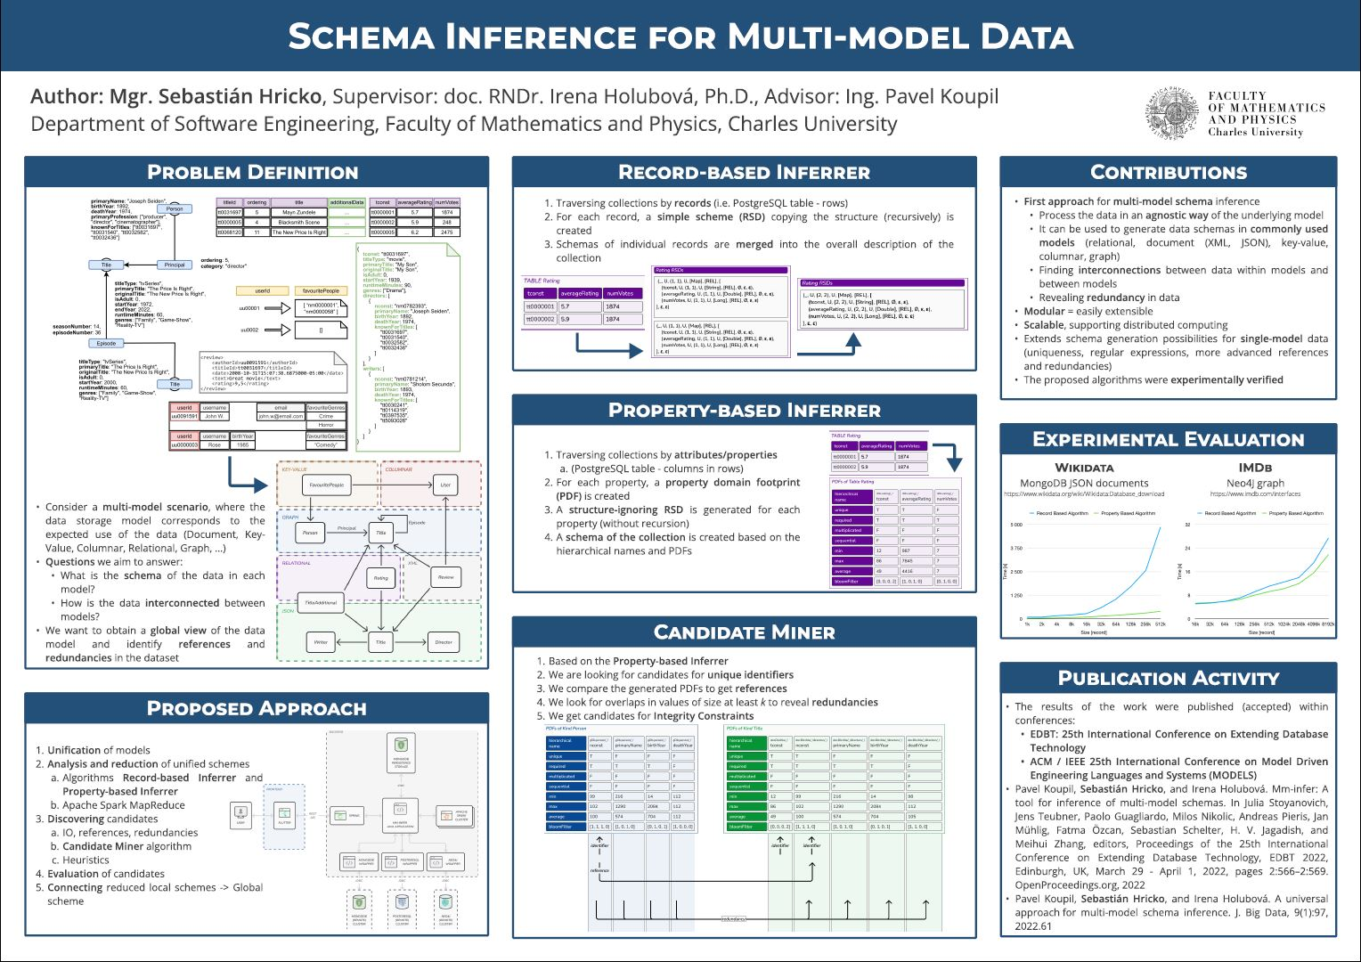
Benefits of Multi-Model Data Fusion in Diagnostics
It enhances diagnostic accuracy by combining diverse data sources and models.
It increases system resilience by providing fault-tolerant and comprehensive analysis.
It supports early detection and predictive maintenance, reducing downtime and costs.
Notes:
Image source: https://www.itspy.cz

Slide 7
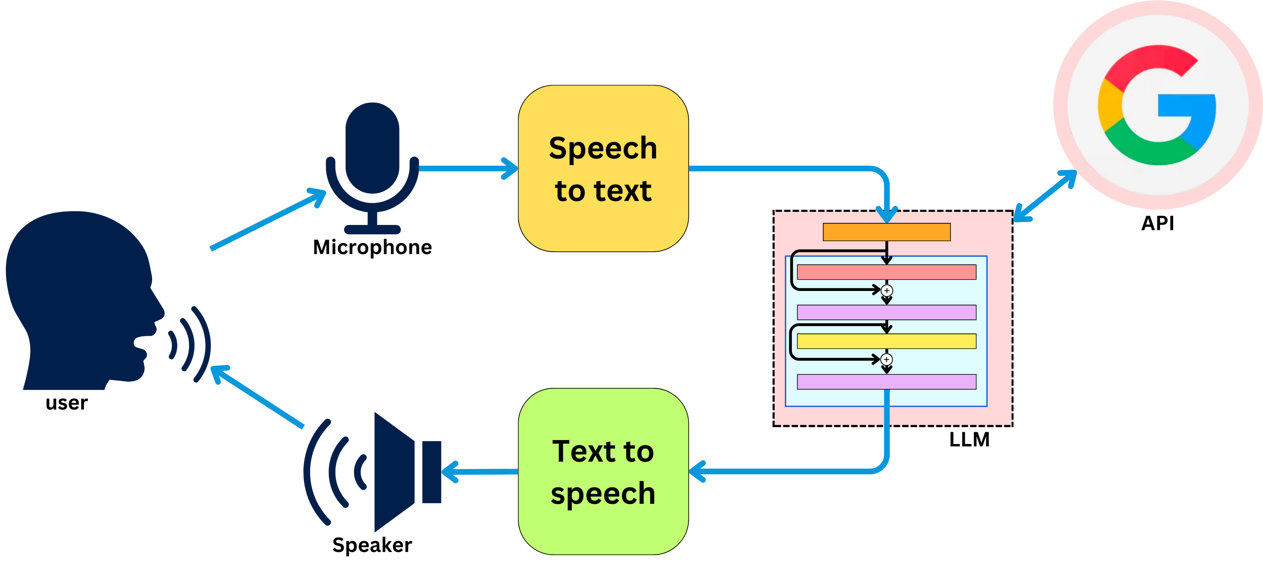
Applications and Future Trends
Applications include medical diagnosis, industrial equipment monitoring, and autonomous vehicles.
Advances in AI and IoT are driving the development of more intelligent and adaptive fusion systems.
Future trends focus on real-time processing, scalable architectures, and explainable AI integration.
Notes:
Image source: https://substackcdn.com

